Slide 1
Enhancement of Underwater Images with Fusion
Judul Lama
Image Enhancement for Underwater Video Stream and Visual-Inertial SLAM for ROV
Judul Baru
By : Hafidz Adhi Pramana
Pembimbing 1 :
Ir. Dadet Pramadihanto, M.Eng., Ph.D
Pembimbing 2 :
Eko Henfri Binugroho, S.ST., M.Sc
Pembimbing 3 :
Raden Sanggar Dewanto, S.T., M.T., Ph.D.
Notes:
Allow me to introduce myself. My name is Hafidz Adhi Pramana from Computer Engineering 2017 and I am here to present my. Final Project
My supervisor for this projectis Mr.Dadet Pramadihanto
and
This presentation is about Enhancement of Underwater Images with Fusion

Slide 2
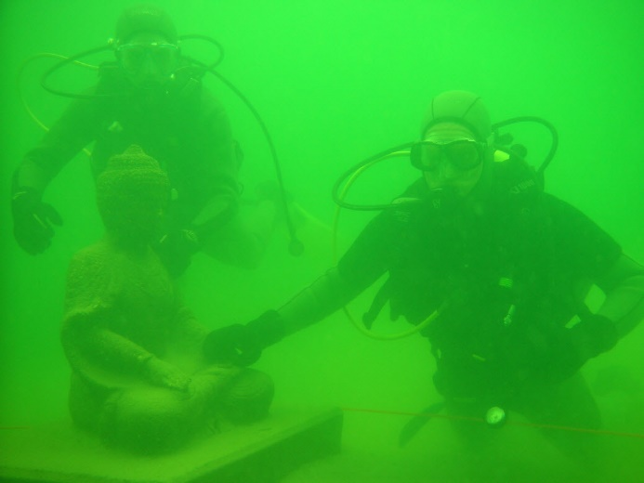
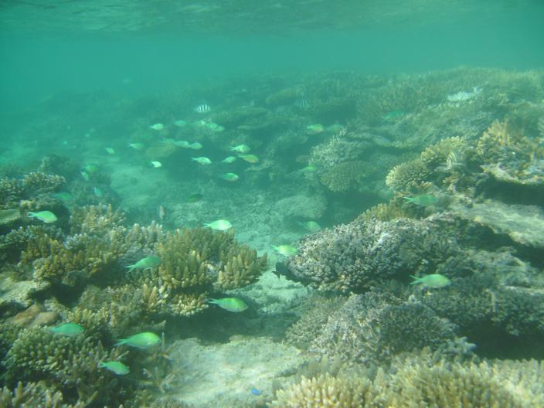
Background of the Study
Capturing clear images in underwater environment is challenging due to haze caused by color scatter in addition to color cast from varying light attenuation in different wavelengths. Color scatter and color cast result in blurred subjects and lowered contrast in underwater images.
.
Notes:
Background of this Final Project
Underwater imaging is challenging due to the physical properties existing in such environments. The main obstacle faced when taking underwater image is loss of color and contrast when diving to significant depths. This is caused by several factors such as color absorption, and light scattering, which causes underwater images to have poor visibility and contrast. Practically, in common sea water, the objects at a distance of more than 10 meters are almost unclear while the colors are faded since their characteristic wavelengths are cut according to the water depth.
Capturing clear images in underwater environments is an important issue of ocean engineering [1]. The effectiveness of applications such as underwater navigational monitoring and environment evaluation depend on the quality of underwater images. Capturing clear images underwater is challenging, mostly due to haze caused by color scatter in addition to color cast from varying light attenuation in different wavelengths [2]. Color scatter and color cast result in blurred subjects and lowered contrast in underwater images.
Water absorbs different wavelengths of light to different degrees. The longest wavelengths, with the lowest energy, are absorbed first. Red is the first to be absorbed, followed by orange & yellow. The colors disappear underwater in the same order as they appear in the color spectrum. Even water at 5ft depth will have a noticeable loss of red. For this reason, strobes are usually used to add color back to subjects.
At What Depth Underwater Does Color Disappear?
Red - 15ft
orange - 25ft
Yellow - 35-45ft
Green - 70-75ft

Slide 3
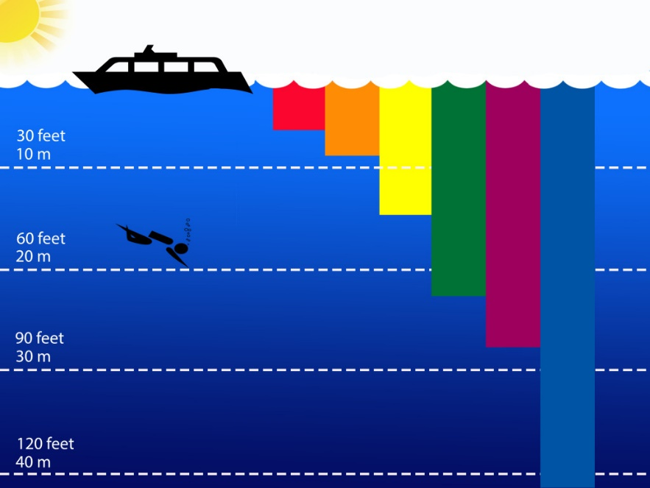
Background of the Study
Water absorbs different wavelengths of light to different degrees. The longest wavelengths, with the lowest energy, are absorbed first. Red is the first to be absorbed, followed by orange & yellow. The colors disappear underwater in the same order as they appear in the color spectrum. Even water at 5ft depth will have a noticeable loss of red.
Notes:
Water absorbs different wavelengths of light to different degrees. The longest wavelengths, with the lowest energy, are absorbed first. Red is the first to be absorbed, followed by orange & yellow. The colors disappear underwater in the same order as they appear in the color spectrum. Even water at 5ft depth will have a noticeable loss of red.
At What Depth Underwater Does Color Disappear?
Red - 15ft
orange - 25ft
Yellow - 35-45ft
Green - 70-75ft

Slide 4
Research Question
The problem in this final project research are :
How to restore underwater images visibility with just single image input.
How to find the weight map of the degraded image input.
How to apply the fusion algorithm to get underwater image with good visibility
Notes:
Bagaimana memperbaiki dan memulihkan visibilitas gambar bawah air hanya dengan satu masukan gambar.
Bagaimana mencari weight map dari input gambar yang terdegradasi.
Bagaimana cara mengaplikasikan algoritma fusion untuk mendapatkan visibilitas citra bawah air yang bagus.
Weight In Image Processing
It refers to a distance between the grayscale intensity of the pixel and the reference intensity specified by the scalar refGrayVal. If you’d like to segment an object with grayscale intensity, pick a value that stands for the object.
What Is The Weight Of An Image?
Compositional factors within an image may have different visual impacts depending on whether or not they possess visual weight. For example, certain objects may feel heavier or more prominent compared to others within an image.

Slide 5
Objective of the Study
The objectives of this final project :
Perform image enhancement on degraded underwater images.
Create underwater images that are more comfortable to view for human and improve image quality.
To build an underwater images enhancement system that can be used on a microcontroller.
Notes:
Melakukan image enhancement pada citra bawah air yang terdegradasi.
Menciptakan citra bawah air yang lebih nyaman untuk dilihat dan meningkatkan kualitas citra secara keseluruhan
Menciptakan sistem underwater image enhancement yang dapat dijalankan di mikrokontroller.

Slide 6
Scope and Limitation of the Study
The limitation of this final project are :
This research is limited only to improve underwater scenes.
Does not discuss how to take underwater pictures.
This system only use a single input from degraded underwater image.
Notes:
Penelitian ini dibatasi hanya untuk perbaikan citra bawah air .
Tidak membahas mengenai cara pengambilan gambar bawah air.
3. Sistem ini hanya menggunakan input tunggal dari gambar bawah air yang terdegradasi.

Slide 7
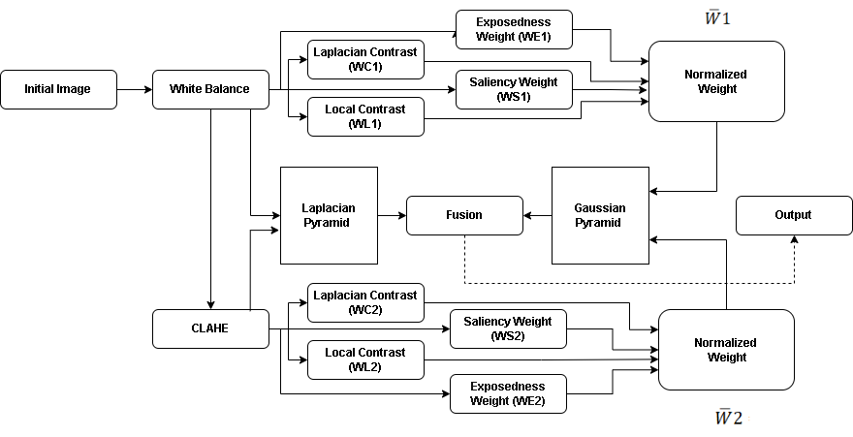
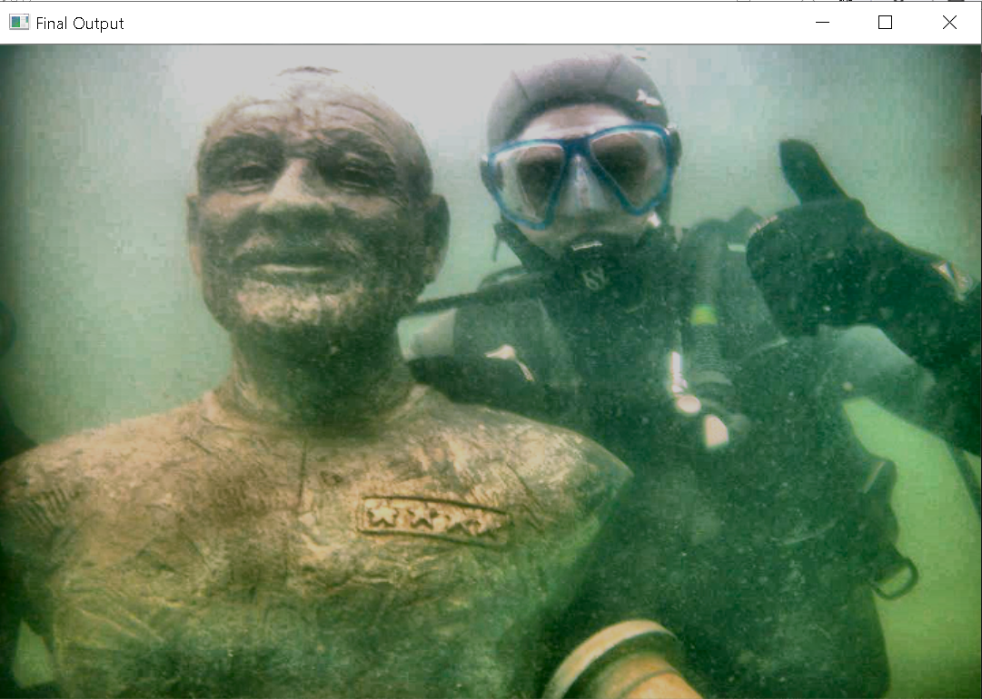
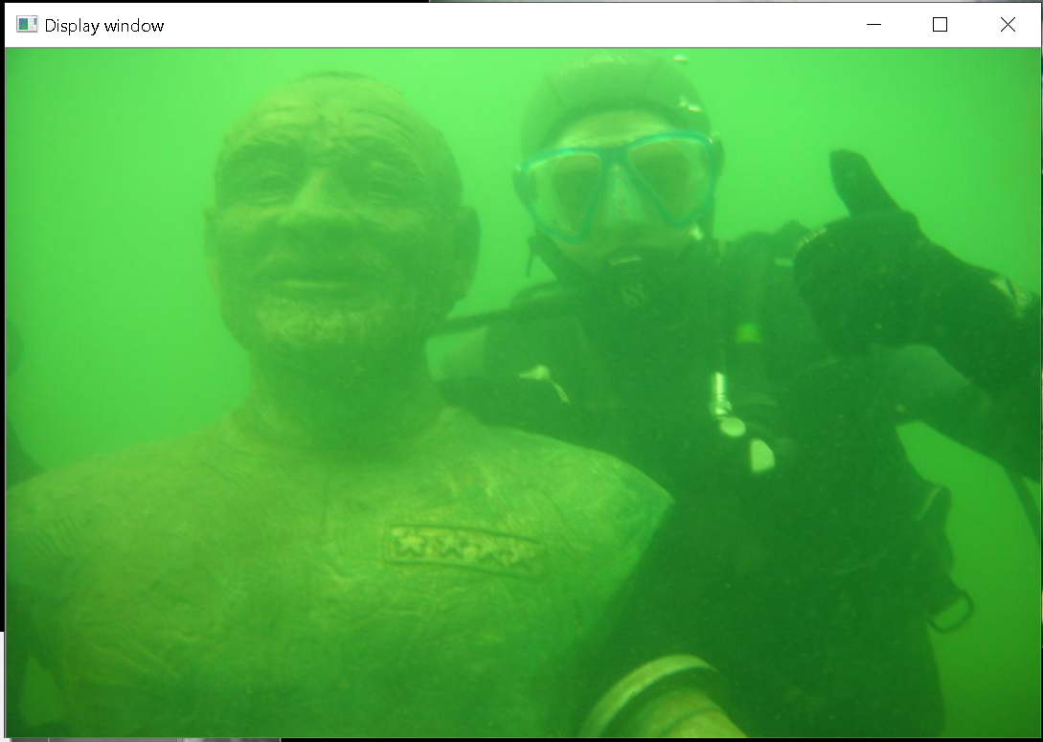
Method Overview
Output
Input
Notes:
Underwater image processing is a process that deals with the investigation of underwater environments and analysis of their artifacts
This enhancing strategy consists of three main steps:
1. Inputs assignment (derivation of the inputs from the original underwater image);
2. Defining weight measures and multiscale;
3. Fusion of the inputs and weight measures.
The first derived input is a white balanced input. This input is obtained using a plain white balancing operation. However, an additional input is required to improve the contrast of the hazy regions in the image since white balancing alone cannot solve the visibility problem. Thus the second input is contrast enhanced version of original hazy image.
the degraded image is firstly white balanced in order to remove the color cast
while producing a natural appearance of the sub-sea images. This partially restored version is then further enhanced by suppressing some of the undesired noise. The second input is derived from this filtered version in order to render the details in the entire intensity range.
The general idea of image
fusion is that the processed result, combines several input
images by preserving only the most significant features of
them.
Thus, results obtained by a fusion-based approach
fulfills the depiction expectation when each part of the result
presents an appropriate appearance in at least one of
the input images.
Image fusion is process of combining multiple input images into a single output image which contain better description of the scene than the one provided by any of the individual input images.
The purpose of image fusion is to combine information from multiple images of the same scene into a single image that ideally contains all the important features from each of the original images. The resulting fused image will be thus more suitable for human and machine perception or for further image processing tasks. Image fusion extracts the information from several images of a given scene to obtain a final image which has more information for human visual perception and become more useful for additional vision processing. It also intends to review quality assessment metrics for image fusion algorithms.

Slide 8
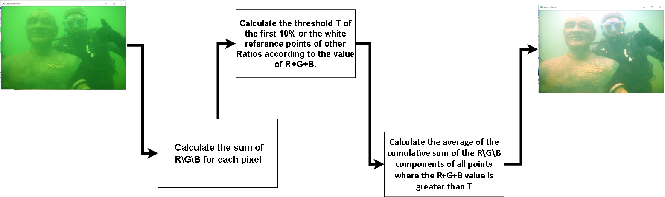
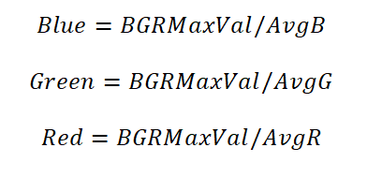
White Balance (Using Perfect Reflection Algorithm)
Principle: Perfect Reflector assumes that the brightest spot on the image is the white point, and uses the white spot as a reference to automatically white balance the image. The brightest spot is defined as the maximum value of R+G+B
Notes:
Firstly, what is white balancing (WB)? It is a color correcting process of removing unrealistic color casts, so that objects which appear white in person are correctly rendered white in your desired image.
the White Patch approach is typical of the Color Constancy adaptation,searching for the lightest patch to use as a white reference similar to how the human visual system does
The principle of this algorithm is: Perfect reflection theory hypothesis The brightest point in the image is the white point, and the white point is used as a reference to perform automatic white balance on the image. The brightest point is defined as the maximum value of R+G+B.
Formulating and solving a class of optimization problems for high-performance gray world automatic white balance
.Perfect reflector method is based on the fact that if the surface of an object is shiny enough, it reflects the actual color of the light source, independently of the color of the surface. Therefore, the R, G, and B components of the brightest or most reflective spot in an image can be used to scale the RGB values of the other image area.
The white-patch algorithm, which is at the heart of many of the various retinex[8] algorithms, presumes that in
every image there will be some surface or surfaces such that there will be a point or points of maximal reflectance for
each of the R, G, and B bands
https://webdev-id.com/wdi-wiki/web-design/color-balance
Sedangkan dalam fotografi, dan pemrosesan gambar, color balance adalah penyesuaian global intensitas warna tertentu menjadi warna netral. Color balance nantinya akan mengubah seluruh campuran warna pada sebuah gambar dan digunakan untuk pengoreksian warna. Meski begitu, versi umum dari color balance sering digunakan untuk mengoreksi warna selain netral atau sengaja mengubahnya untuk sekedar mendapatkan efek.
While human visual system is equipped with good color constancy in most situations,
the digital camera has to rely on color balancing algorithm to discount the illumination
effect and extract the invariable object color.
white balance" means giving the image pleasant appearance by discounting the
effect of illumination that is consistent with some aesthetic norm
Color constancy refers to the ability of the visual system to perceive stable object color,
despite spatial and temporal changes in the illumination.
Color constancy refers to our ability to perceive colors as relatively constant over varying illuminations (i.e. light sources). For example, a red apple will still look red on a sunny day or cloudy day – or in a grocery store or a home.
White patch adalah salah satu algoritma dari color constancy
Color constancy atau ketetapan warna adalah salah satu keistimewaan dari sistem penglihatan manusia, yang mengusahakan agar warna yang diterima dari suatu benda terlihat sama meskipun berada pada kondisi pencahayaan yang berbeda-beda. However, when we look at the apple, the resultant image on the retina is based not only on its intrinsic red, but also on the spectrum of the light source striking it. By this logic, the apple would shift in color depending on the surrounding illumination. Thankfully, our brain employs the process of color constancy, which “undoes” the surrounding illumination and allows us to perceive objects as a consistent color in different settings.
Formulating and solving a class of optimization problems for high-performance gray world automatic white balance
White balance is a common practice in photograph or image processing to compensate for the ambient light, which performs adjustment of the intensities of the colors, i.e., red, green, and blue primary colors, for a given image. The main objective of this adjustment is to render the neutral colors, specifically the white color, in an image correctly so that color casts due to the ambient light are removed. A general extension of white balance is color balance, which ensures that colors other than the white are also reproduced correctly
White balance adalah fungsi untuk membuat hal-hal berwarna putih tampak putih dalam fotografi dengan memgkompensasi pengaruh warna cahaya di bawah lingkungan pengambilan gambar. Cahaya berbeda memiliki warna dan karakteristik berbeda.
The white-patch retinex algorithm compares the RGB of white under the canonical to the maximum found in each of the 3 image bands separately.
This approach is typical of the Color Constancy adaptation where it searches for the lightest patch to use as a white reference similar to how the human visual system does. Note that for white to be observed in the image, each channel in you RGB color space should be at its maximum value.
White Patch (Perfect Reflection) It assumes that for each color channel there is at least one pixel in the image with maximal reflection of the illumination source light for that channel and when these maximal reflections are brought together, they form the color of the illumination source. This approach is typical of the Color Constancy adaptation where it searches for the lightest patch to use as a white reference similar to how the human visual system does. Note that for white to be observed in the image, each channel in you RGB color space should be at its maximum value.
Principle: Perfect Reflector assumes that the brightest spot on the image is the white point, and uses the white spot as a reference to automatically white balance the image. The brightest spot is defined as the maximum value of R+G+B
The perfect reflection is based on the assumption: assuming that the brightest point on the picture is the white point, this point can perfectly reflect three colors, and automatically white balance the image with this point as a reference.

Slide 9
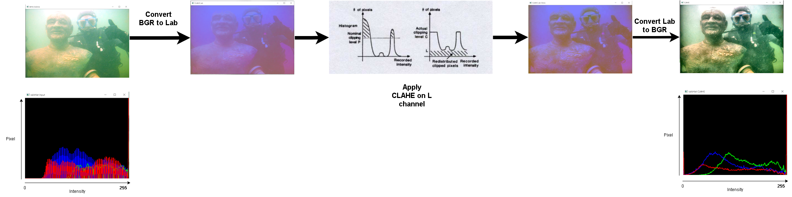
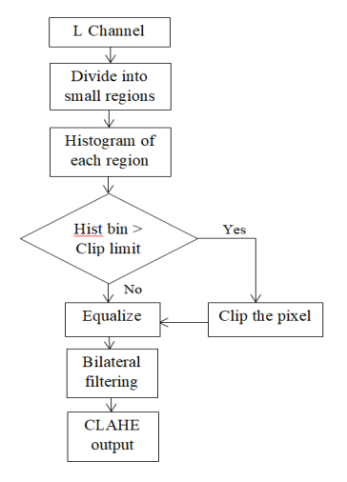
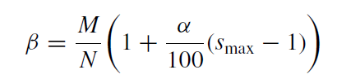
CLAHE (Contrast-Limited Adaptive Histogram Equalization)
α = Clip limit factor (0-100) β = Clip limit
M= Number of pixel N = grayscale value (256)
S max = Maximum Slope
Notes:
CLAHE (Contrast Limited Adaptive Histogram Equalization) is an algorithm for enhancing local contrast in images, and is frequently used in application areas like underwater photography, traffic control, astronomy, and medical imaging.
Adaptive histogram equalization (AHE) differs from ordinary histogram equalization in the respect that the adaptive method computes several histograms, each corresponding to a distinct section of the image, and uses them to redistribute the lightness values of the image. It is therefore suitable for improving the local contrast and enhancing the definitions of edges in each region of an image.
AHE has a tendency to overamplify noise in relatively homogeneous regions of an image. A variant of adaptive histogram equalization called contrast limited adaptive histogram equalization (CLAHE) prevents this by limiting the amplification.
The procedure used by CLAHE
algorithm involves partitioning of a given grayscale image into
contextual regions and then equalizes the histogram of each
region. The CLAHE applies contrast limiting technique to each
neighborhood grid point within a particular region from which a
transformation is derived. Noise amplification is reduced by
clipping image histogram at a predefined value just before
computing the Cumulative Distribution Function (CDF) for each
grid point. CLAHE is shown to be superior to the original AHE
for its improved noise performance, although it does not
completely eliminate noise enhancement in smooth regions, and
the selection of contrast gain limit is image-dependent.
Recipes for CLAHE
The Basic routine
1. Compute the neighborhood histogram for each pixel in the image.
2. Clip each histogram at a predefined value and redistribute the clipped histogram equally among all the histogram bins.
3. Compute the CDF (Cumulative Distribution Function) and transformation function for each pixel using the clipped histogram.
4. Apply the transformation function to each pixel to get the equalized image.
Dealing with color image
Instead of applying CLAHE separately to the R, G, B channel of a color image, a better approach would be applying the algorithm only to the luminance channel of a color image, which also prevents the unwanted hue and saturation change, however requires the source image to be converted to a Lab color space first.
CLAHE [10] was an improvement over AHE. CLAHE algorithm divides an image into tiles, i.e., contextual regions. It
creates the histogram of each contextual region and clipping is performed at predefined value. The clipped amount is redistributed among the histogram bins. This histogram is the modified form of the original histogram. This method solves
the edge-shadowing effect of AHE and reduces the problem of over-enhancement. CLAHE has demonstrated its success for the enhancement of low contrast medical images. The parameters that should be taken under consideration for CLAHE are clip limit of histogram and size of the contextual region. These parameters can affect the CLAHE output. This method makes hidden features of the image more visible by redistributing the used gray values.
Histogram
Histogram is a graphical representation of the intensity distribution of an image. In simple terms, it represents the number of pixels for each intensity value considered.
Contrastive Limited Adaptive Equalization
Contrast Limited AHE (CLAHE) differs from adaptive histogram equalization in its contrast limiting. In the case of CLAHE, the contrast limiting procedure is applied to each neighborhood from which a transformation function is derived. CLAHE was developed to prevent the over amplification of noise that adaptive histogram equalization can give rise to.
Histogram Equalization
Histogram Equalization is a computer image processing technique used to improve contrast in images. It accomplishes this by effectively spreading out the most frequent intensity values, i.e. stretching out the intensity range of the image. This method usually increases the global contrast of images when its usable data is represented by close contrast values. This allows for areas of lower local contrast to gain a higher contrast.
Adaptive Histogram Equalization
Adaptive Histogram Equalization differs from ordinary histogram equalization in the respect that the adaptive method computes several histograms, each corresponding to a distinct section of the image, and uses them to redistribute the lightness values of the image. It is therefore suitable for improving the local contrast and enhancing the definitions of edges in each region of an image.
Histogram Equalization adalah metode pemrosesan gambar yang bertujuan untuk mengatur kontras gambar dengan memodifikasi distribusi intensitas histogram.
Permasalahan peningkatan kontras yang terlalu lebih pada Adaptive Histogram Equalization dapat diatasi dengan menggunakan CLAHE, yaitu memberikan nilai batas pada histogram.
CLAHE merupakan teknik perbaikan kontras citra dengan meningkatkan kontras lokal citra. Lokal citra ini didapat dengan membentuk beberapa grid simetris pada citra yang disebut dengan region size.
Nilai batas atau cliplimit merupakan batas maksimum suatu histogram. Cara menghitung cliplimit suatu histogram dapat didefinisikan sebagai berikut
Metode Contrast Limited Adaptive Histogram Equalization (CLAHE) bertujuan untuk mengurangi noise dengan cara menentukan kernel matriks dan bekerja dengan menggantikan nilai intensitas setiap pixel citra masukan dengan rata-rata dari nilai pembobotan kernel untuk setiap pixel-pixel tetangganya dan pixel itu sendiri. Metode CLAHE memberikan nilai batas pada histogram. Nilai batas ini disebut dengan clip limit yang menyatakan batas maksimum tinggi suatu histogram. Cara menghitung clip limit suatu histogram dapat didefinisikan sebagai berikut.
Metode Contrast Limited Adaptive Histogram Equalization (CLAHE) bertujuan untuk mengurangi noise dengan cara menentukan kernel matriks dan bekerja dengan menggantikan nilai intensitas setiap pixel citra masukan dengan rata-rata dari nilai pembobotan kernel untuk setiap pixel-pixel tetangganya dan pixel itu sendiri. Pada proses pengurangan noise ukuran kernel sangat mempengaruhi dalam memperoleh hasil kualitas citra.
Histogram is a graphical representation of the intensity distribution of an image. Which simply means, the number of pixels for each intensity value that ranges from 0 to 255.
Removing noise while
preserving edges of an input image

Slide 10
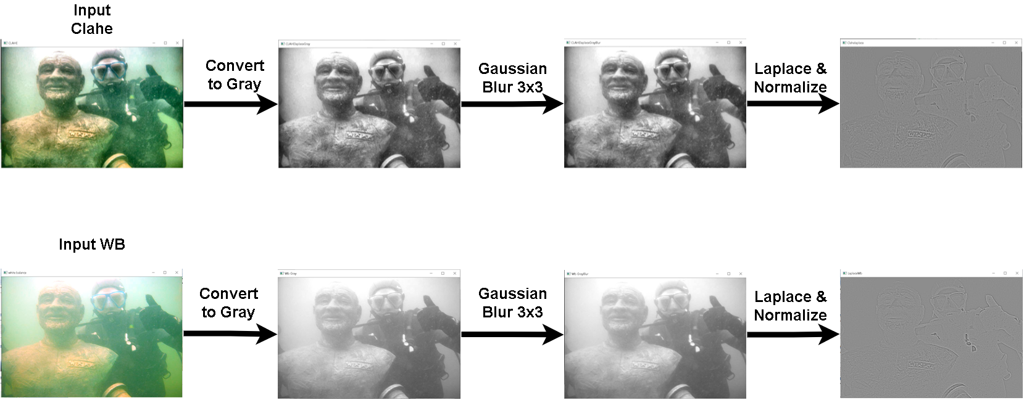
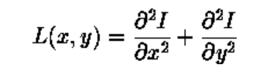
Laplacian Contrast Weight
where x and y are the standard Cartesian coordinates of the xy-plane
Notes:
Laplacian contrast weight (WL) deals with global contrast by applying a Laplacian filter on each input luminance channel and computing the absolute value of the filter result. The Laplacian filter detects sudden intensity transitions in the image and highlights the edges.
A Laplacian filter is an edge detector used to compute the second derivatives of an image, measuring the rate at which the first derivatives change. This determines if a change in adjacent pixel values is from an edge or continuous progression.
Laplacian filter kernels usually contain negative values in a cross pattern, centered within the array. The corners are either zero or positive values. The center value can be either negative or positive. The following array is an example of a 3x3 kernel for a Laplacian filter.
Laplacian Contrast Weight menangani kontras global dengan menerapkan filter Laplacian pada setiap chanel pencahayaan input dan menghitung nilai absolut dari hasil filter. Laplacian Filter digunakan untuk menghitung turunan kedua dari suatu gambar, mengukur kecepatan perubahan turunan pertama. Laplacian dari sebuah gambar menyoroti daerah dengan perubahan intensitas yang besar dan karena itu sering digunakan untuk mendeteksi edge. Persamaan matematika dari Laplacian operator adalah sebagai berikut :
.
Laplacian Operator is also known as a derivative operator which is used to find edges in an image.
Sum of 2nd derivative of the image of Respective X 2nd derivative of the image of Respective Y
Kernel Laplacian filter biasanya berisi nilai negatif dalam pola silang, berpusat di dalam array. Sudut-sudut dari kernel ini adalah nilai nol atau positif. Nilai pusat kernel dapat berupa nilai negatif atau positif.
The Laplacian of an image highlights regions of rapid intensity change and is an example of a second order or a second derivative method of enhancement [31]. It is particularly good at finding the fine details of an image. Any feature with a sharp discontinuity will be enhanced by a Laplacian operator. The Laplacian is a well-known linear differential operator approximating the second derivative given by Eq. (11

Slide 11
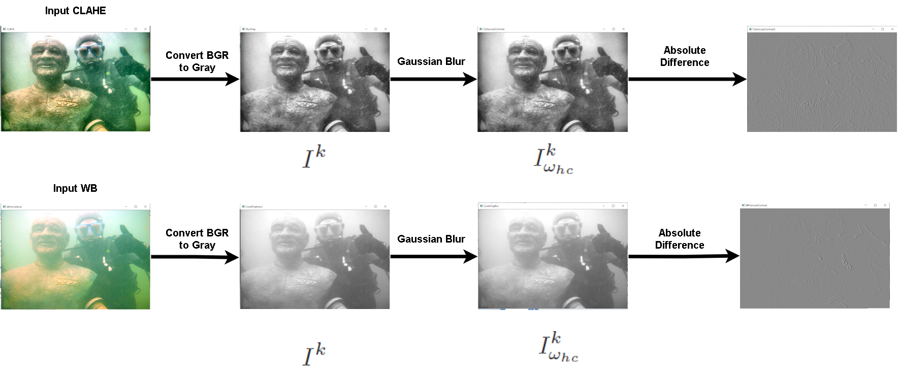
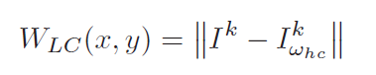
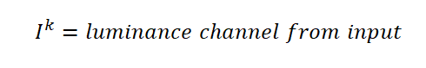
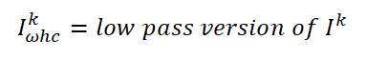
Local Contrast
Notes:
Local Contrast weight is used to detect the local change of the input image, and can get
better edge information and texture changes
Local contrast weight (WLC) comprises the relation between each pixel and its neighborhoods average. The impact
of this measure is to strengthen the local contrast appearance since it advantages the transitions mainly in the
highlighted and shadowed parts of the second input. The (WLC) is computed as the standard deviation between pixel
luminance level and the local average of its surrounding region:
Bobot kontras lokal (Local Contrast Weight) terdiri dari hubungan antara setiap piksel dan rata-rata piksel di sekitarnya. Tujuan dari langkah ini adalah untuk memperkuat tampilan kontras. Local Contrast Weight didapatkan dengan menghitung standar deviasi tingkat kecerahan antar piksel dan rata-rata lokal dari piksel di sekitarnya:
where represents luminance channel from image input and Ik omegahc represents the low pass version of it. The filtered version is obtained by employing a small 5 × 5 binomial kernel with with the high frequency cut-off value ωhc = π/2.75
Dimana Ik mewakili chanel luminance (kecerahan) dari input dan Ik omegahc mewakili versi low pass nya. Didapatkan dengan mengaplikasikan 5x5 binomial kernel dengan frekuensi cut off = π/2.75

Slide 12
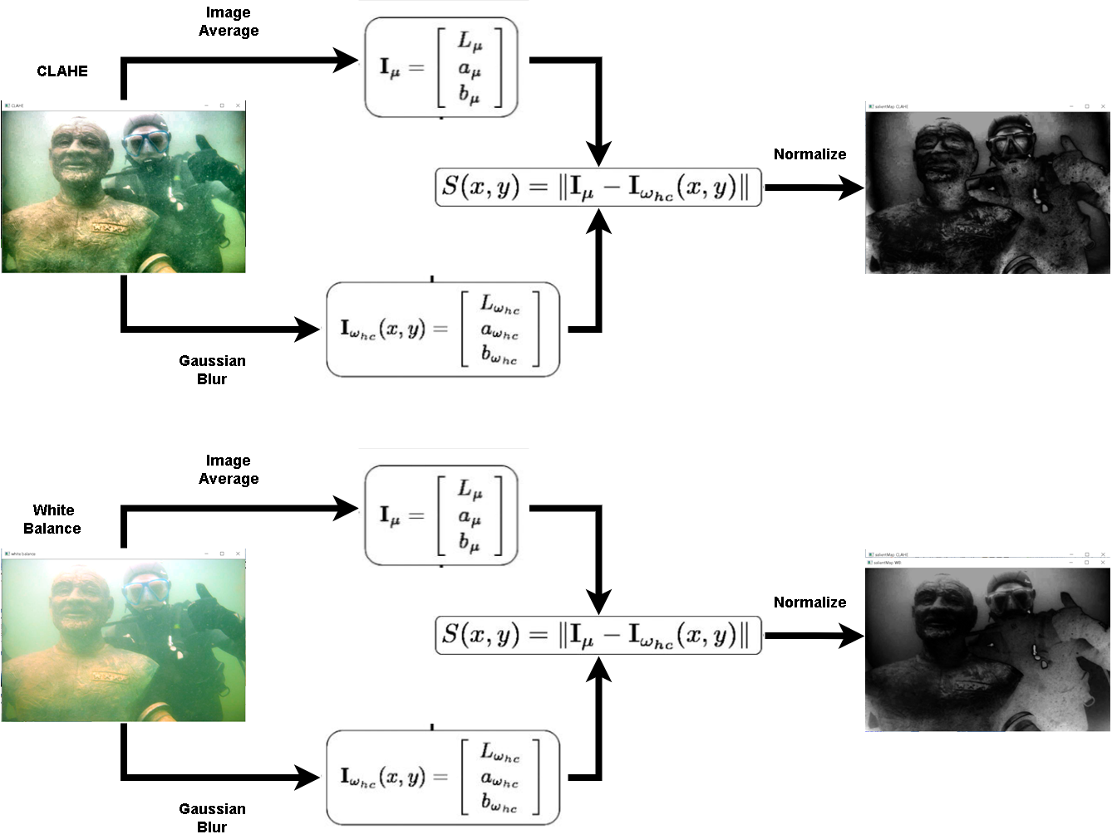
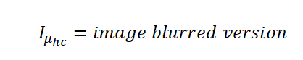
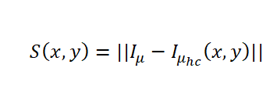
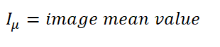
Saliency Weight (Frequency-tuned)
Notes:
Saliency is that quality of an image which highlights the presence of an object, or rather a pixel with respect to its surrounding, thus grasping our attention.
Saliency Weight is aims to emphasize the discriminating objects that lose their prominence in the underwater scene.
The saliency map is defined as the absolute difference between the image mean
value and a blurred version of the image
Saliency Map adalah gambar di mana kecerahan piksel mewakili seberapa menonjol piksel tersebut, yaitu kecerahan piksel berbanding lurus dengan saliencynya. Pada umumnya ini adalah gambar grayscale. Saliency map juga disebut sebagai heat map dimana hotness(titik panas) mengacu pada daerah-daerah pada citra yang memiliki pengaruh besar dalam memprediksi kelas objek tersebut.
Tujuan dari peta saliency adalah untuk menemukan daerah-daerah yang menonjol atau terlihat di setiap lokasi di bidang visual dan untuk memandu pemilihan lokasi yang dikunjungi, berdasarkan distribusi spasial saliency.
Dalam computer vision, peta saliency adalah gambar yang menunjukkan kualitas unik setiap piksel.
1.Perform Gaussian filtering on the image img to obtain gfrgb;
2. Convert image imgrgb from RGB color space to LAB color space imglab;
3.Take the average of the images of the L, A, and B channels of the converted image imglab to obtain lm, am, bm;
4.Calculate the saliency value, that is, take the Euclidean distance and sum the average image of the three channels and the filtered image respectively;
5.Use the maximum value to normalize the saliency map.
Achanta et al. [78] propose a method to restore color and contrast image properties
through the exploitation of a saliency-based technique. In particular, they start by proving
that the most popular saliency estimation methods do not fully exploit the entire frequency
content of an input image. Indeed, they observe that almost every state-of-the-art method
includes, at some point of the proposed processing pipeline, a downsampling module
which necessarily implies a loss of information. This loss affects the details and resolution
properties of the output result. Hence, the authors propose a novel method based on the
preliminary band-pass filtering of the image through a Difference of Gaussians (DoG) [30]
operator, with properly chosen parameters, such that the image spectral content is largely
preserved. The saliency map is defined as the absolute difference between the image mean
value Im and a blurred version of the image, obtained by applying the DoG filter:
. Untuk mendapatkan saliency map, disini saya menggunakan algoritma saliency dari Achanta et al. Dalam metode Achanta, kontras center-surround dihitung sebagai jarak Euclidean antara rata-rata vektor L a b dari piksel tengah dan sekitarnya. Nilai saliency pada piksel posisi (x; y) diberikan sebagai:
Dimana nilai peta fitur Ft(x,y) adalah jarak Euclidean d diantara piksel vektor L a b c(x,y) (tengah) dan rata-rata piksel L a b St(x,y) pada jendela t(sekeliling).

Slide 13
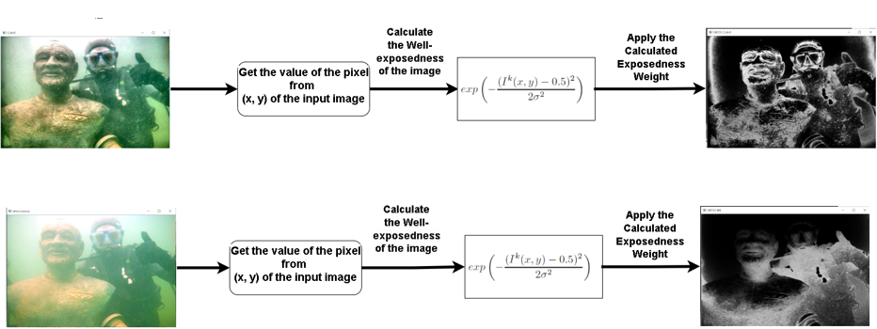
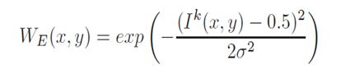
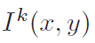
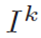
Exposedness Weight
CLAHE
White Balance
Where represent the value of the pixel location (x,y) from input image while the standard deviation is set to = 0.25.
Notes:
Exposedness weight (WE) evaluates how well a pixel is exposed. We want to keep intensities that are not near zero (underexposed) or one (overexposed). Commonly, the pixels tend to have a higher exposed appearance when their normalized values are close to the average value of
0.5.
This assessed quality provides an estimator to preserve a constant appearance of the local contrast, that ideally is neither exaggerated nor understated.
Looking at just the raw intensities within a channel, reveals how well a pixel is exposed. We want to keep intensities that are not near zero (underexposed) or one (overexposed). We weight each intensity i based on how close it is to 0.5 using a Gauss curve: exp − (i−0.5)2 2σ2 , where σ equals 0.2 in our implementation. To account for multiple color channels, we apply the Gauss curve to each channel separately, and multiply the results, yielding the measure E.
Exposure adalah banyak sedikitnya paparan dari cahaya yang nantinya akan bisa diterima oleh sensor yang ada di sebuah kamera agar bisa mendapatkan gambar dan juga foto yang bagus. pengaturan exposure memang akan menjadi satu hal yang akan membuat foto bisa terlihat lebih bagus atau bahkan menjadi lebih jelek nantinya. Ketika kita mengatur exposure dengan kondisi cahaya yang masuk ke foto jumlahnya terlalu tinggi tentunya akan membuat gambar akan menjadi sangat terang, atau bisa kita katakan sebagai over exposure. Hal ini juga akan bisa terjadi sebaliknya, kalau kita mengambil foto dengan pengaturan exposure yang akan membuat cahaya yang masuk ke foto sedikit, tentunya akan membuat gambar yang telah kita ambil tersebut akan menjadi semakin gelap atau bisa kita sebut dengan under exposure. Dengan adanya hal ini menunjukkan kalau pengaturan eksposur yang tepat akan bisa membuat foto mendapatkan pencahayan yang pas.

Slide 14
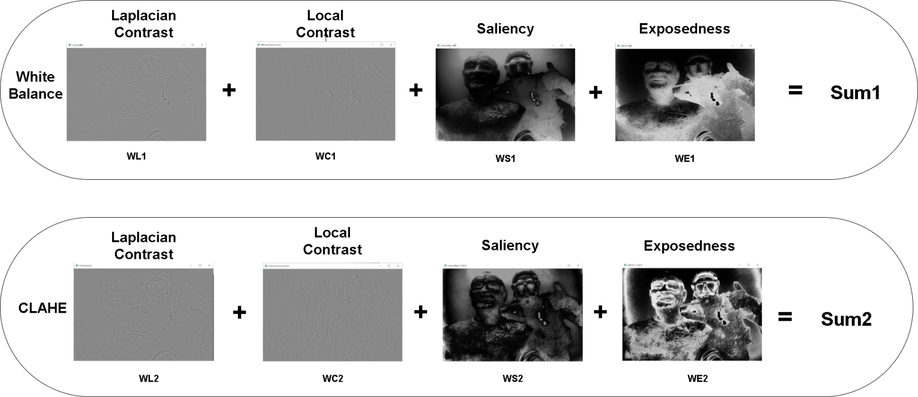
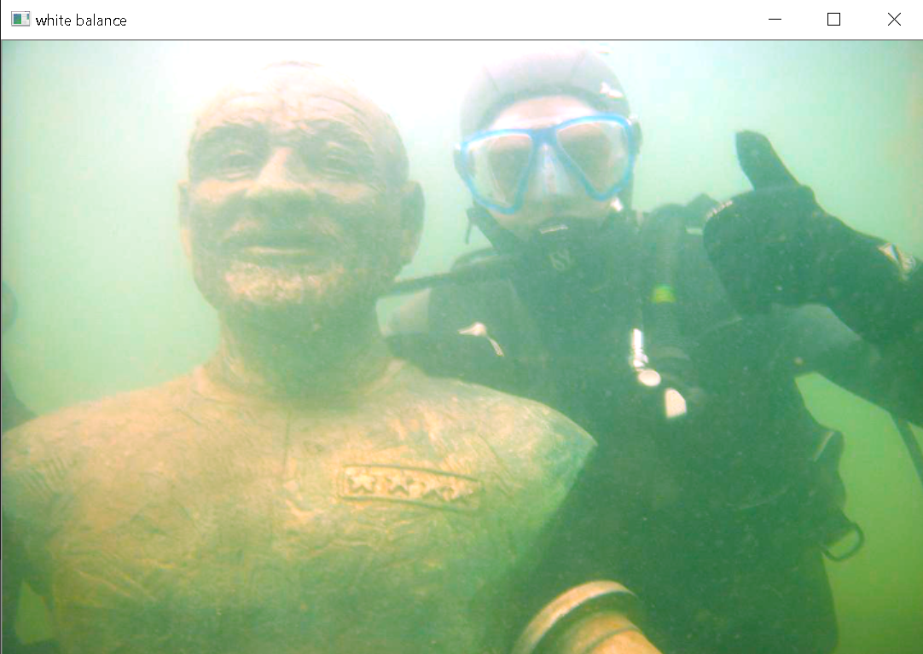
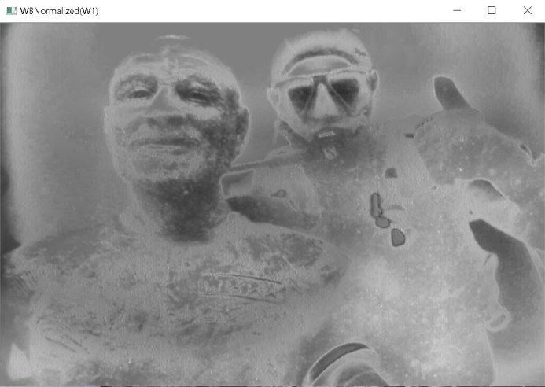
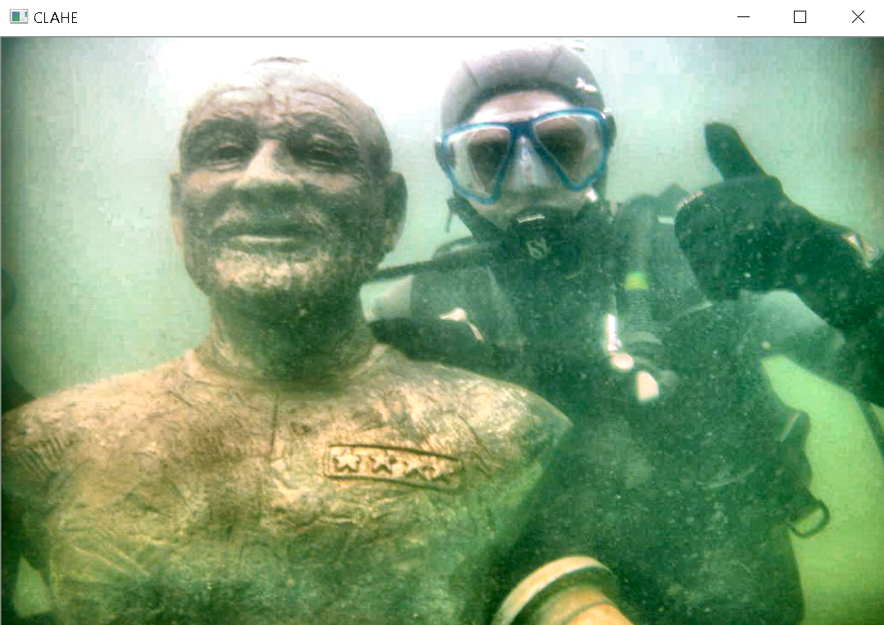
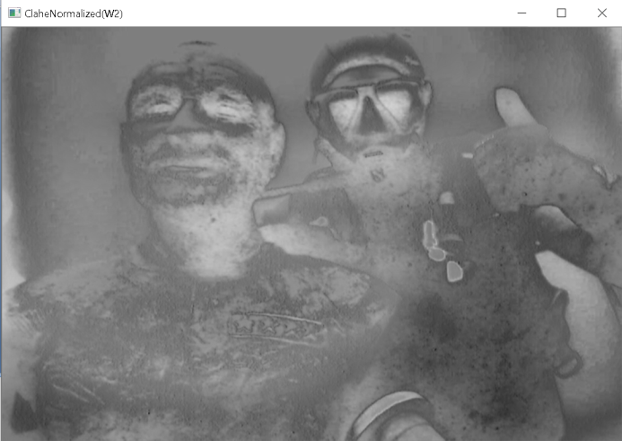
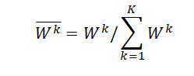
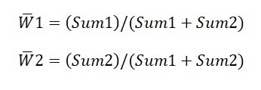
Normalize Weight
In order to facilitate the subsequent weighted fusion, each weight map must be normalized first, and the equation can be shown as follow:
Notes:
Four weight maps are merged in a single weight map as follows. For each input k, a a result of weight map Wk is first obtained by summing up the WL , WC, WS , and WE at weight maps.
the input image I is processed by Laplacian Pyramid,
and the normalized weight W is processed by Gaussian Pyramid,

Slide 15
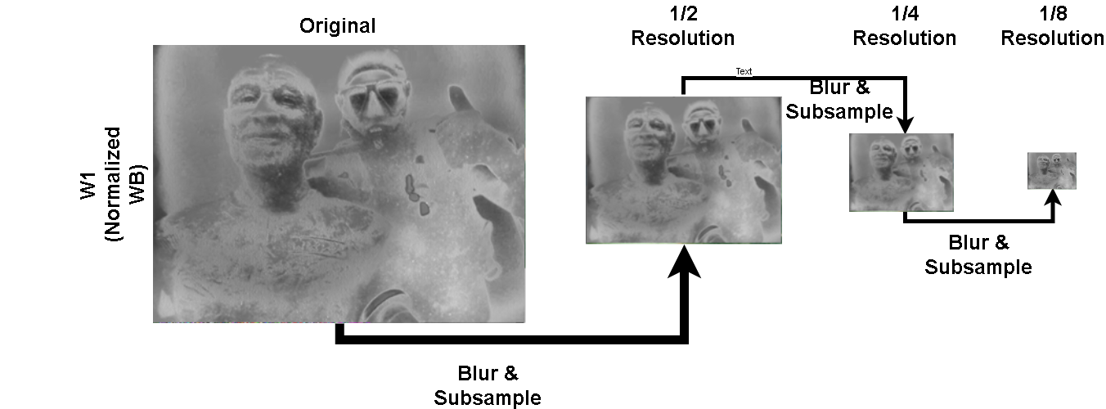
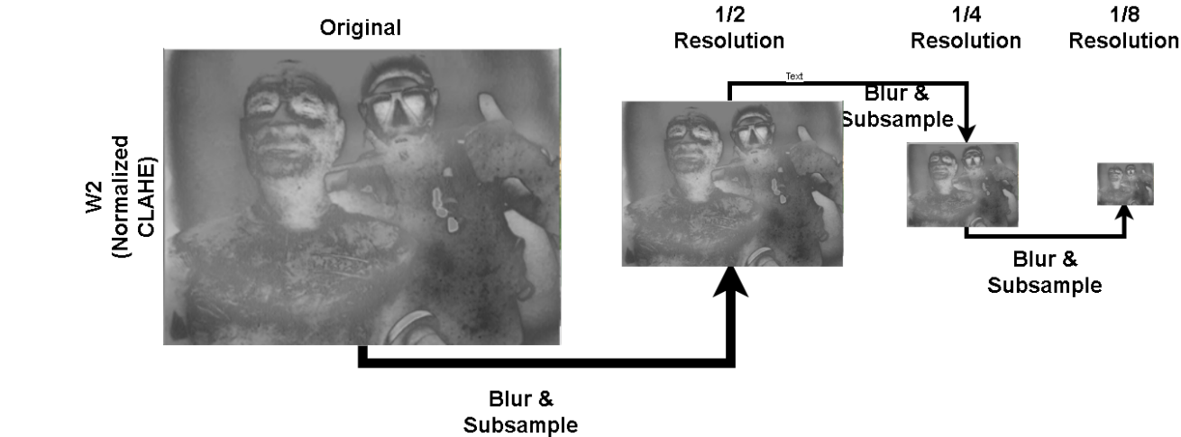
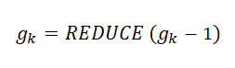
Gaussian Pyramid (Normalized Weight)
Goal: Develop representation to decompose images into
information at multiple scales, to extract feature or structure
of interest, to attenuate noise.
Notes:
The Gaussian pyramid is a technique in image processing that breaks down an image into successively smaller groups of pixels to blur it. when a digital photograph is blurred in this way, edges of objects are easier to detect, enabling a computer to identify them automatically.
Gaussian Pyramid is the representative method to build a multi-scale representation of an image. It consists of two steps: (1)smoothing to remove high-frequency components that could result aliasing, and (2)down-sampling: reduce the image size by half.
Smoothing, which is also called blurring, is done by convolving the image with Gaussian filter as is described before. The second step, down-sampling, means simply taking every second pixel from image in the last step and reconstruct the down-scaled version of the image.
Image pyramid refers to the way of representing an image at multiple resolutions. The idea behind this is that features that may go undetected at one resolution can be easily detected at some other resolution. For instance, if the region of interest is large in size, a low-resolution image or coarse view is sufficient. While for small objects, it’s beneficial to examine them at high resolution. Now, if both large and small objects are present in an image, analyzing the image at several resolutions can prove beneficial. This is the main concept behind image pyramids. The name “pyramid” because if you place the high-resolution image at the bottom and stack subsequent low-resolution images on top, the appearance resembles that of a pyramid.
The first step in Laplacian pyramid coding is to low-pass
filter the original image go to obtain image gl . We say that gl
is a “reduced” version of go in that both resolution ansda mple
density are decreased. In a similar way we form g2 as a reduced
version of g,, and so on. Filtering is performed by a
procedure equivalent to convolution with one of a family of
local, symmetric weighting functions. An important member
of this family resembles the Gaussian probability distribution,
so the sequence of images go, gl , -., g,, is called the Gaussian
pyramid.’
Gaussian pyramid: Used for downsampling. The top of the Gaussian pyramid is obtained by removing consecutive rows and columns (usually even numbers) in the bottom image . The value of each pixel in the top image is equal to the Gaussian weighted average of 5 pixels in the next image. In this way, an MxN image at a time becomes an M/2xN/2 image. So the area of ​​this image becomes a quarter of the original image area. This is called an Octave (an octave). Carrying out such operations continuously will result in an image pyramid with a decreasing resolution.
An “image pyramid” is a multi-scale representation of an image.
Utilizing an image pyramid allows us to find objects in images at different scales of an image. And when combined with a sliding window we can find objects in images in various locations.
At the bottom of the pyramid we have the original image at its original size (in terms of width and height). And at each subsequent layer, the image is resized (subsampled) and optionally smoothed (usually via Gaussian blurring).
The image is progressively subsampled until some stopping criterion is met, which is normally a minimum size has been reached and no further subsampling needs to take place.

Slide 16
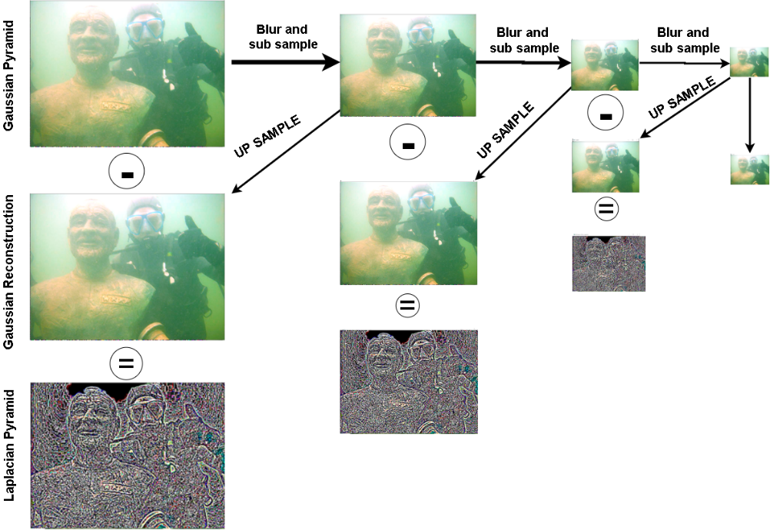
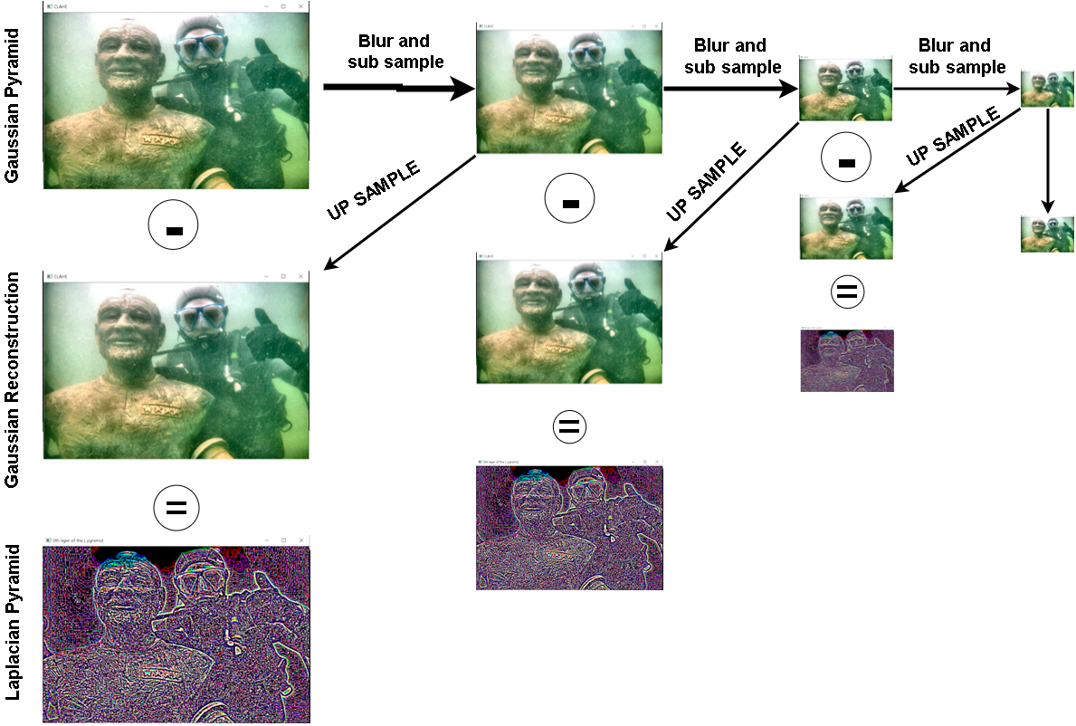
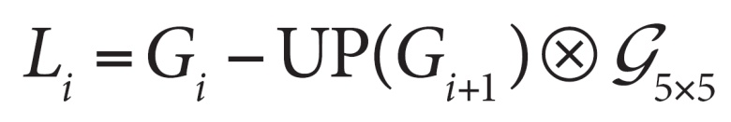
Laplacian Pyramid (WB & CLAHE)
1. Read in two images (input from White Balance and CLAHE) 2. Build a Gaussian pyramid from those input 3. Calculate the Laplacian pyramid based on the Gaussian pyramid 4. In Laplacian Perform image fusion on each layer 5. Rebuild the original image based on the fused image pyramid.
Notes:
The Laplacian pyramid builds from the Gaussian pyramid. The Gaussian pyramid serves to represent information, in this case an image, at different scales, at each of which the information from the original is preserved. In short, the Gaussian pyramid is a sequence of images, starting with the original, the original shrunk by ½, the original shrunk by ¼, and so on. At every transition of the pyramid, we want to downscale the image by a factor of ½.
To upsample the smaller image, we upsample with interpolation, which is upsampling followed by filtering. Upsampling by a factor of 2 inserts 1 zero between every pixel of the original image. Then we perform lowpass filtering on this image with a Gaussian filter, to remove imaging artifacts and abnormalities inserted by the upsampling. We then subtract the upsampled image (blue box) from the image at the current scale in the Gaussian pyramid. These images will be the same size after upsampling, and the result is the Laplacian at the current scale.
Laplacian Pyramids are formed from the Gaussian Pyramids. A level in Laplacian Pyramid is formed by the difference between that level in Gaussian Pyramid and expanded version of its upper level in Gaussian Pyramid.
A Laplacian pyramid is very similar to a Gaussian pyramid but saves the difference image of the blurred versions between each levels. Only the smallest level is not a difference image to enable reconstruction of the high resolution image using the difference images on higher levels. This technique can be used in image compression.
Image pyramid refers to the way of representing an image at multiple resolutions. The idea behind this is that features that may go undetected at one resolution can be easily detected at some other resolution. For instance, if the region of interest is large in size, a low-resolution image or coarse view is sufficient. While for small objects, it’s beneficial to examine them at high resolution. Now, if both large and small objects are present in an image, analyzing the image at several resolutions can prove beneficial. This is the main concept behind image pyramids. The name “pyramid” because if you place the high-resolution image at the bottom and stack subsequent low-resolution images on top, the appearance resembles that of a pyramid.
1. Read in two images, apples and sentences 2. Build a Gaussian pyramid of apples and oranges (6 layers) 3. Calculate the Laplacian pyramid based on the Gaussian pyramid 4. In Laplacian Perform image fusion on each layer (the left side of the apple is fused with the right side of the orange) 5. Rebuild the original image based on the fused image pyramid.
The process show as below:

Slide 17
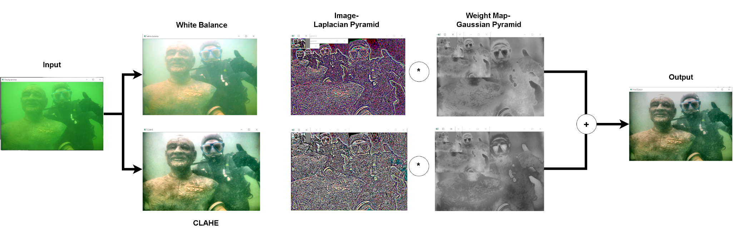
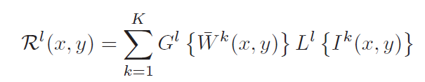
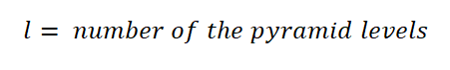
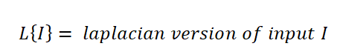
Fusion Process
Notes:
Improved Weight Map Guided Single Image Dehazing, International Journal of Engineering Research & Technology (IJERT)
Image fusion in the simplest terms is the process wherein information from multiple images is combined to form a single image.
. Pixel level image fusion refers to the processing of various combination of detail information gathered through different sources for better understanding of a scene. The multi-scale fusion provides an optimized solution for fusing different images since it is fast and operated by per pixel computational manner.
l represents the number of the pyramid levels and L(I) is the Laplacian
version of the input I while G(W) represents the Gaussian version of the normalized
weight map of the W. This step is performed successively for each pyramid layer, in
a bottom-up manner.
Image fusion is defined as the process of combining multiple input images into a single composite image. Our aim is to create from the collection of input images a single output image which contains a better description of the underwater
scene than the one provided by any of the individual input images. The output image should therefore be more useful for human visual perception or for machine perception.
The main idea is to use image fusion to combine the useful properties and suppress the disadvantages of the various enhancement techniques
2) addWeighted()
This function calculates the weighted sum of two matrices. It can be used for blending two images. The linear blend function used can be represented as g(x) = (1-α)f0(x)+αf1(x). Here α value may range from 0 to1 which indicates the cross-dissolve between two images.

Slide 18
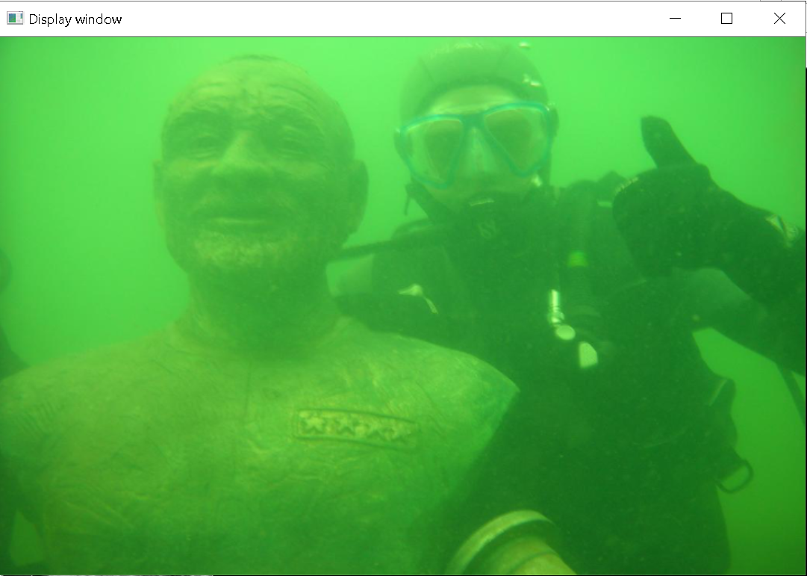

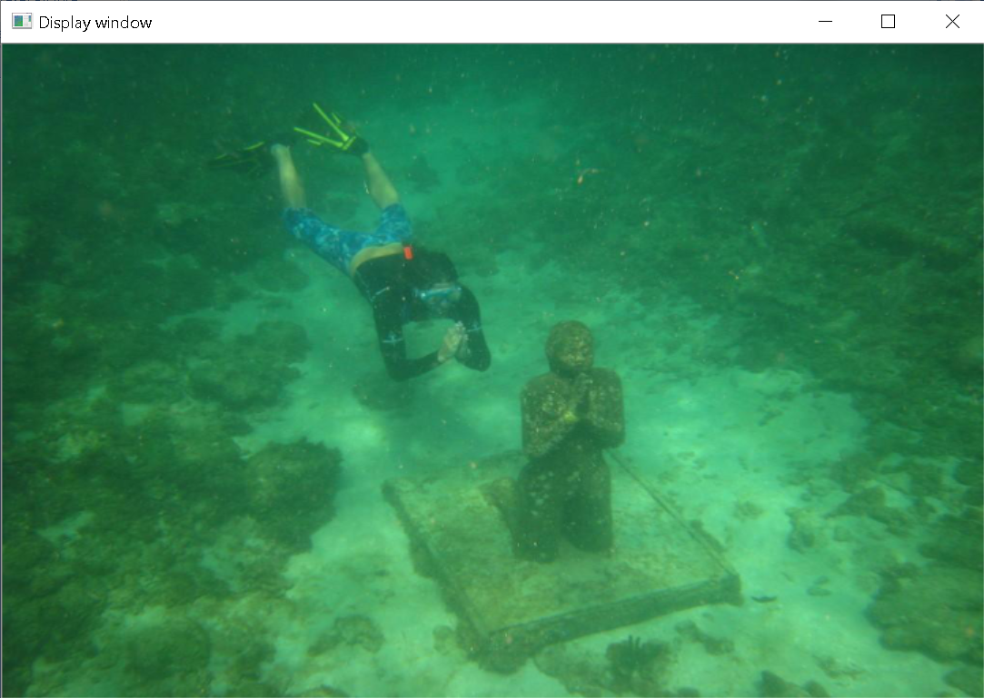
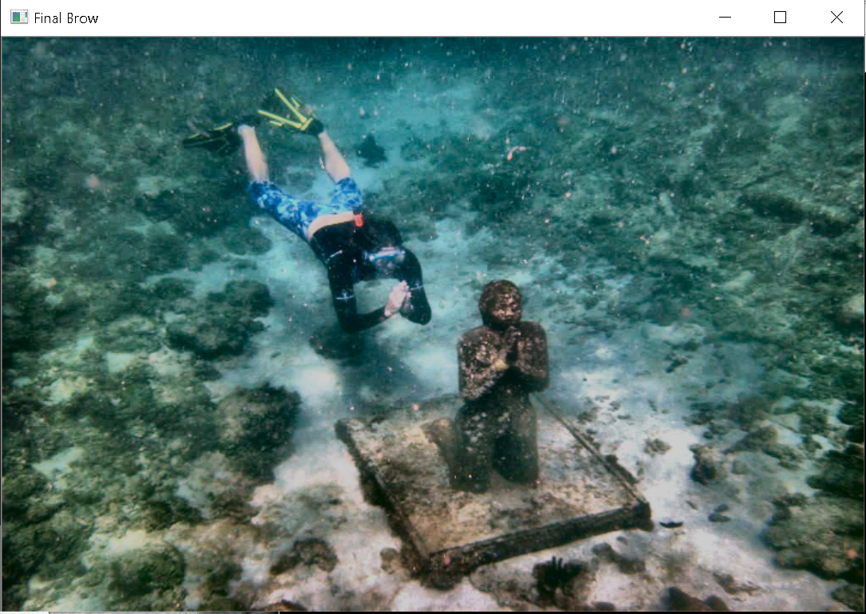
Test Results
INPUT
OUTPUT
1.)
2.)

Slide 19
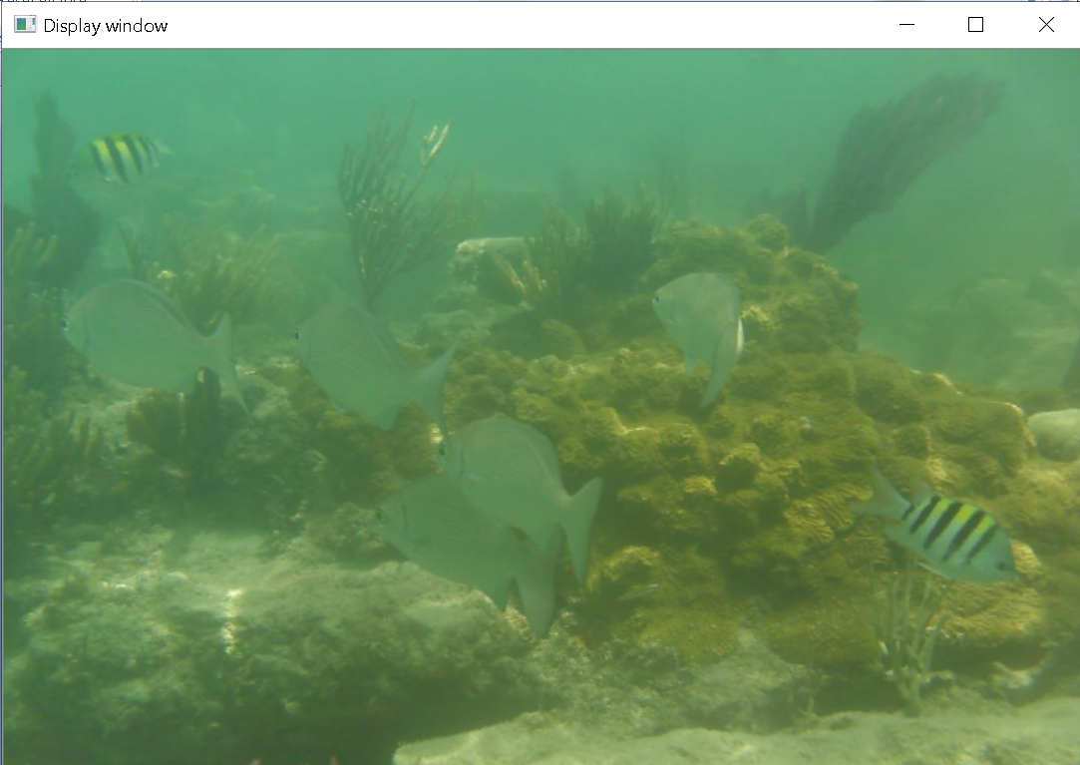
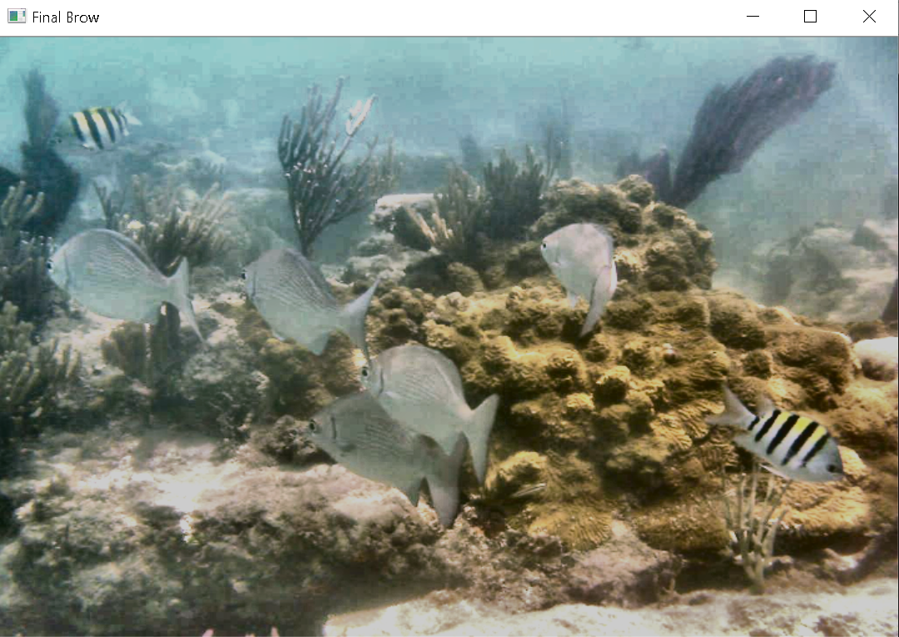
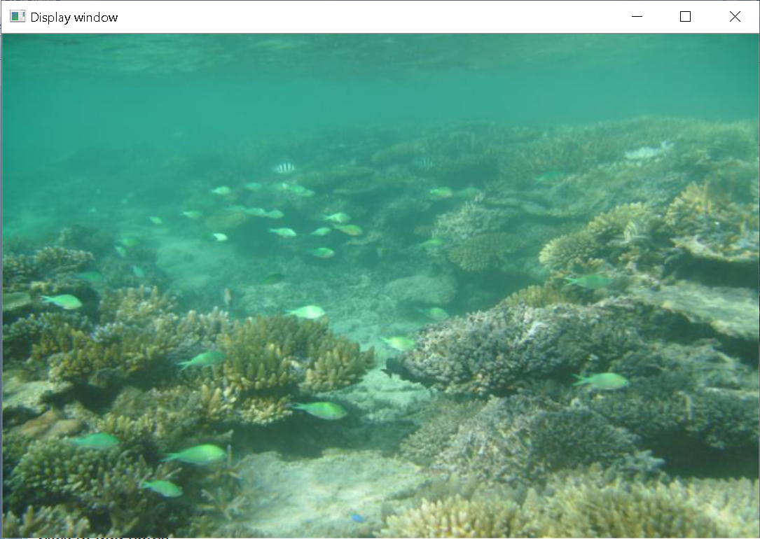
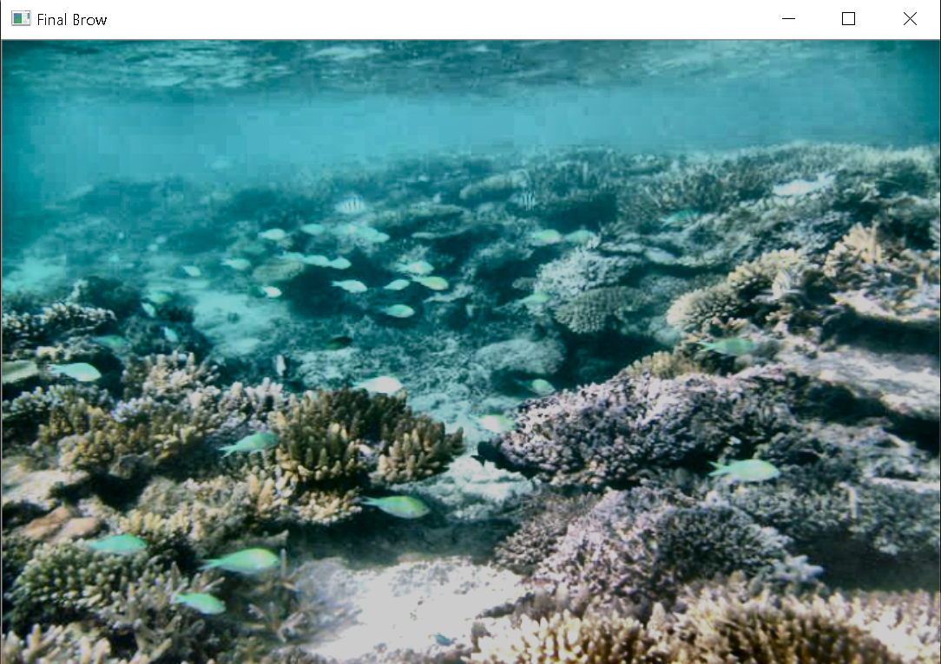
INPUT
OUTPUT
3.)
4.)

Slide 20
Conclusion
This Image Enhancement with Fusion system can recover degraded underwater images so that they can be easily seen by the human eye.
This system only uses a single image as input. The single image then processed using the White Balance and CLAHE algorithms. White Balance aims to improve image quality by eliminating unwanted color casts. While CLAHE aims to improve contrast in images.

Slide 21
THANK YOU
Notes:
That’s all for my Final Project presentation and thank you so much for your attention

